Slide 1
Sprint 3 Review
Serializing Data
Jon Honda
December 7, 2017

Slide 2
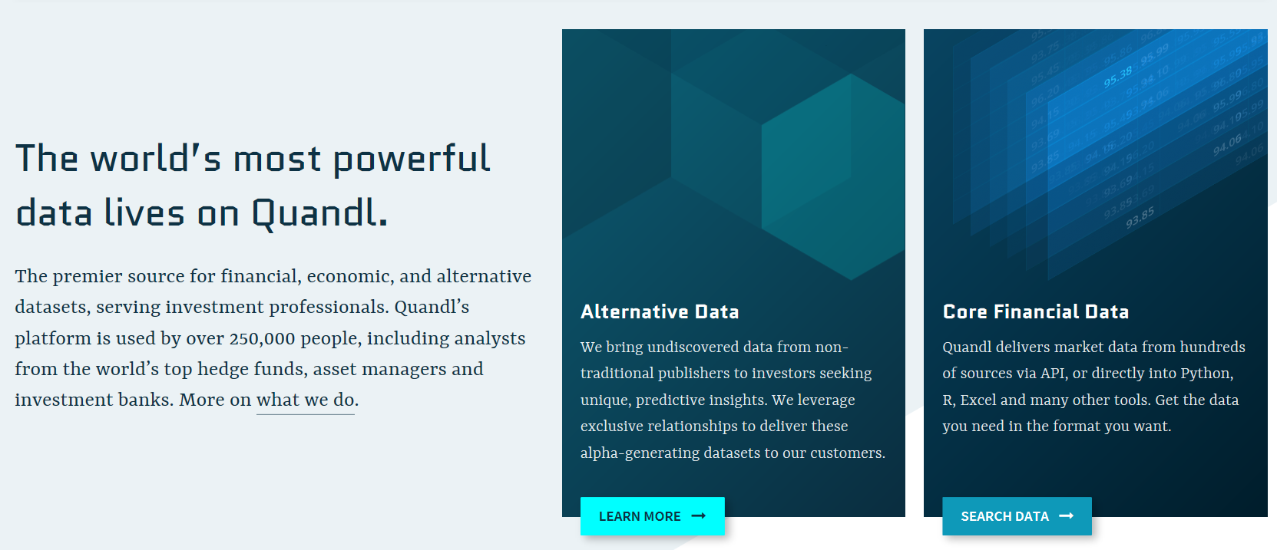

What is…

Slide 3
Sprint Objectives
Get Quadl Data
Make Database
Query Database
Write to Database

Slide 4
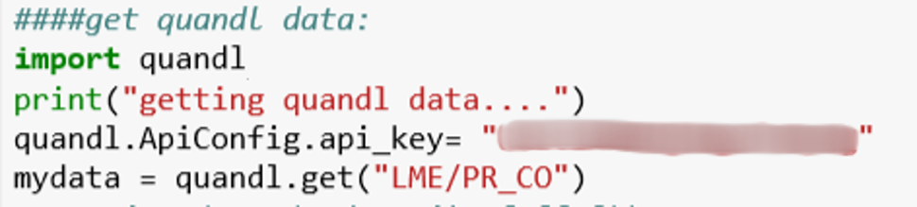
Get Quandl Data
Invoke quandl library
Write to variable
Use Quandl API to
get cobalt price data set
Get Quadl Data
Make Database
Query Database
Write to Database

Slide 5
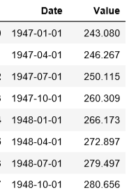

Python code…
Pandas Data Type
data as “tables” of rows & columns
Get Quadl Data
Make Database
Query Database
Write to Database

Slide 6
Data Types
Pandas
64 bit float
datetime
*Different Data Types = Different Abilities
Get Quadl Data
Make Database
Query Database
Write to Database

Slide 7
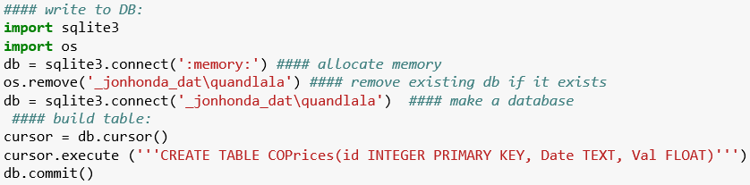
Python code…
Directory
DB File
Makes the database table.
The language is SQL
Make DB
Query DB
Write to DB
Get Quadl Data

Slide 8
Make Database
Defines Field
Table Name
Data Type
Field Name
Make DB
Query DB
Write to DB
Get Quadl Data

Slide 9




Incompatible Data Types!
64 bit float
datetime
Make DB
Query DB
Write to DB
Get Quadl Data

Slide 10
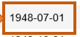
Solve Incompatibility
mydata
Looks the same, but computer reads it differently!
rowi
Change type
Make DB
Query DB
Write to DB
Get Quadl Data

Slide 11
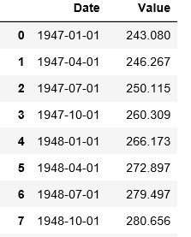
Write all mydata to Database
Write mydata @rowi to DB
Advance to next rowi
Read & translate mydata @rowi
rows
mydata
Start @ rowi=0
End @ rowi=Last Row
Make DB
Query DB
Write to DB
Get Quadl Data

Slide 12
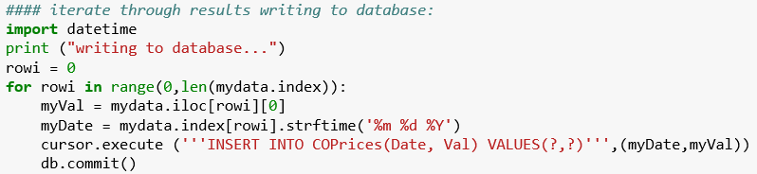
Write all mydata to Database
Write mydata @rowi to DB
Advance to next rowi
Read & translate mydata @rowi
rows
mydata
Start @ rowi=0
End @ rowi=Last Row
Read & Translate
Write to DB

Slide 13
Write all mydata to Database
Writes data at rowi to DB
The language is SQL
Make DB
Query DB
Write to DB
Get Quadl Data

Slide 14
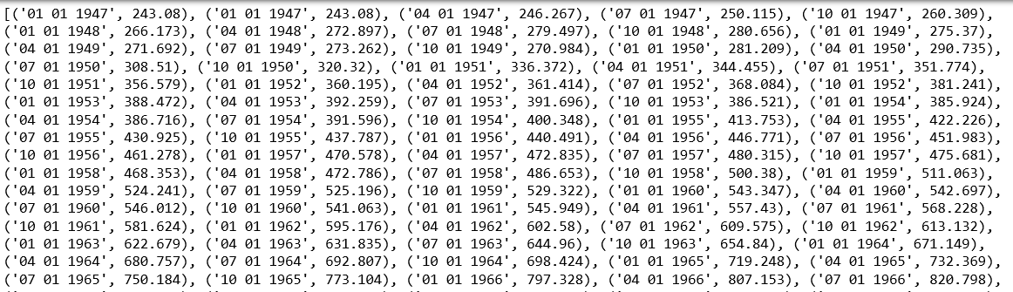
Get Data from Database
Make DB
Query DB
Write to DB
Get Quadl Data

Slide 15
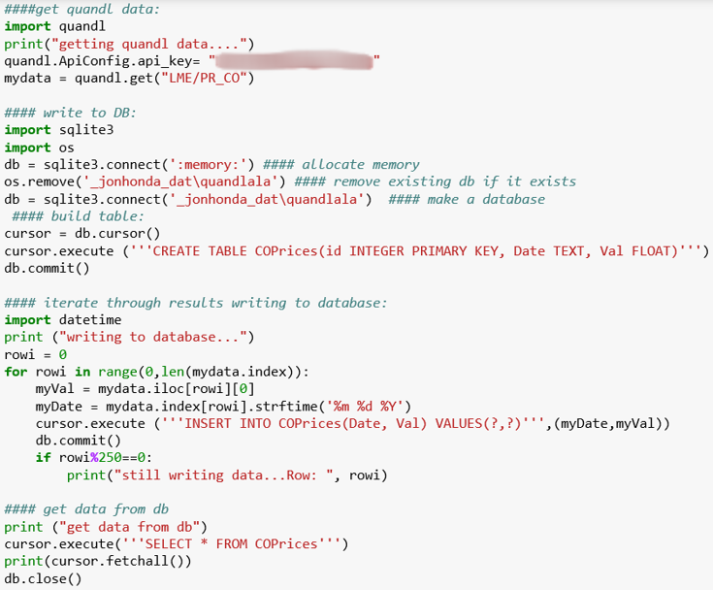
Sprint Objectives
Get Quadl Data
(Python)
Make Database
Write to Database
Query Database

Slide 16
Fin

